Slide 1
Welcome!
Lesson 1 - Web Development
Notes:
This slideshow is both a teaching resource and a learning resource.

Slide 2
Lesson 1
HTML Basics

Slide 3
Intros!
Hello!
Web development is a collaborative process – let’s introduce ourselves!
State your:
Name
Grade
School
A fun fact about you!

Slide 4
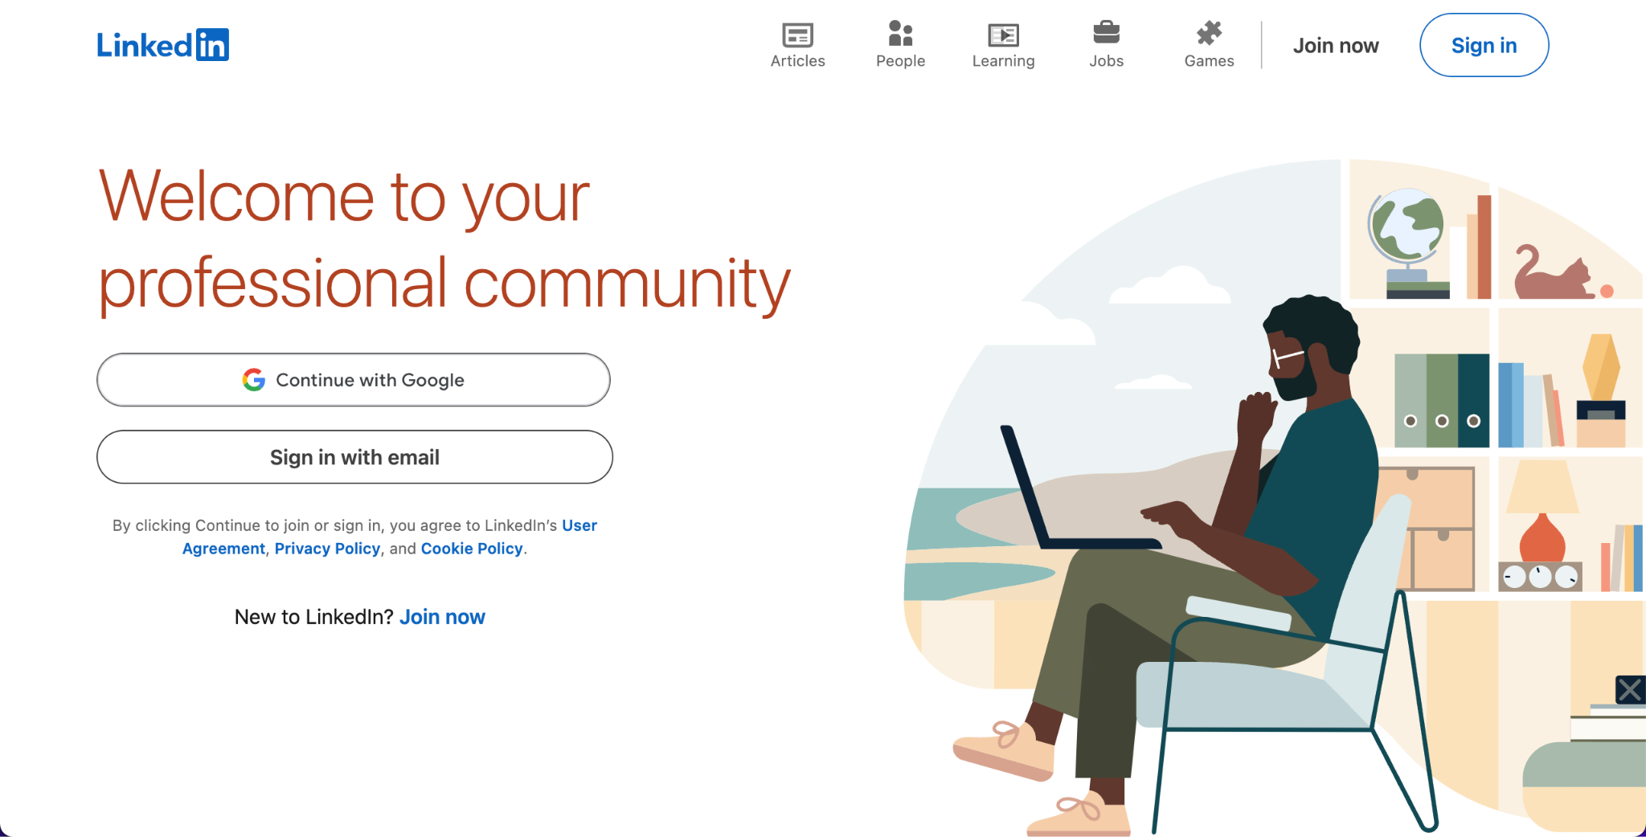
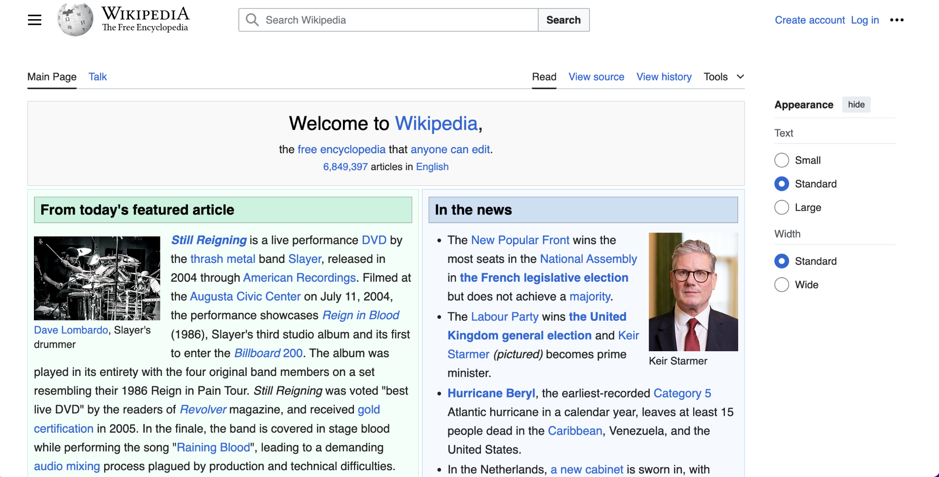
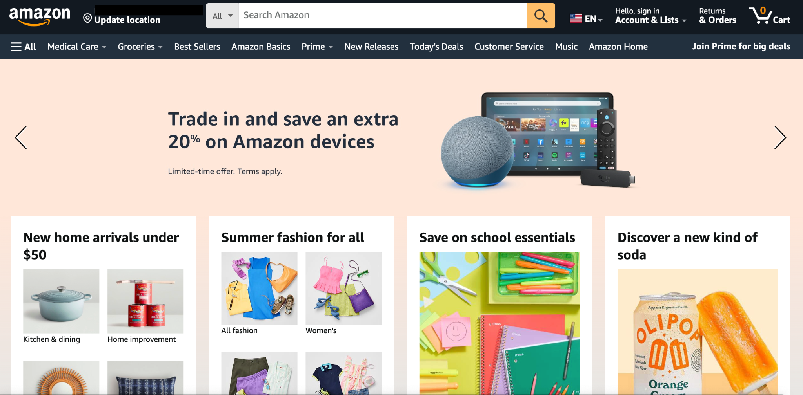
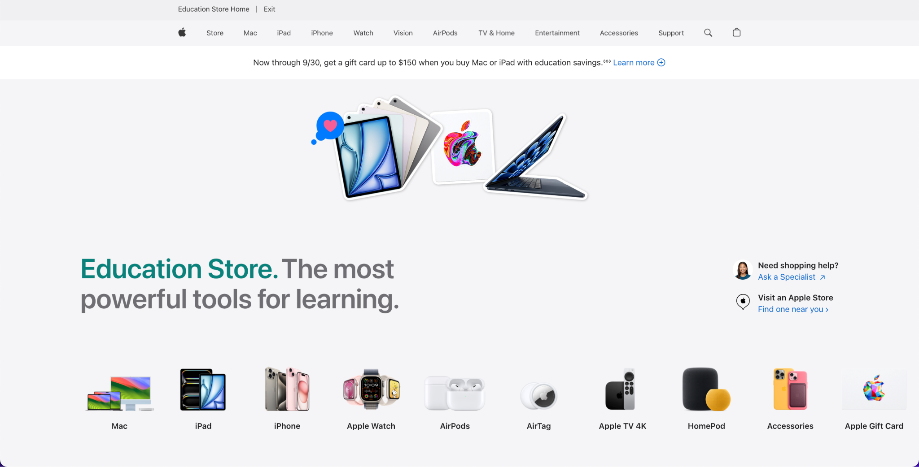
Let’s look at some cool websites!
What’s your favorite website? Examples: Amazon, Apple, Wikipedia, Linkedin
Notes:
To see all website examples, go to “Slideshow” mode and click repeatedly, as the website screenshots will appear and disappear due to the animations set.

Slide 5
So what is HTML?
Hyper Text Markup Language
Used in every single webpage!
What does HTML do?
Structure
Comprised of a series of elements
What do these “elements” do?
Label pieces of content
Tell browser how to display that content
Notes:
https://www.w3schools.com/html/html_intro.asp

Slide 6
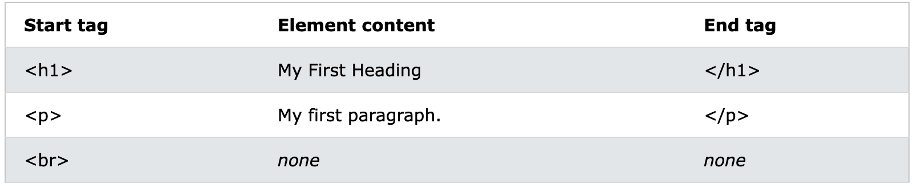
What’s an HTML Element?
Template:
<tagname> Content goes here... </tagname>
Everything from start tag to end tag. Examples:
<h1>My First Heading</h1>
<p>My first paragraph.</p>
Some elements (empty elements) don’t have any content and don’t have an end tag, like <br>.
Notes:
https://www.w3schools.com/html/html_intro.asp

Slide 7
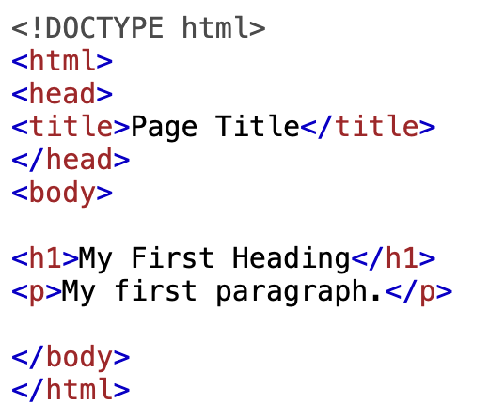
Example HTML Program
<!DOCTYPE html> declaration: this document is an HTML5 document
<html> element is root element of an HTML page
<head> element contains meta information about the HTML page
The <title> element specifies a title for the HTML page (in title bar/page tab)

Slide 8
Example HTML Program (cont)
<body> element defines the document's body
is a container for all the visible contents
<h1> element defines a large heading
<p> element defines a paragraph

Slide 9
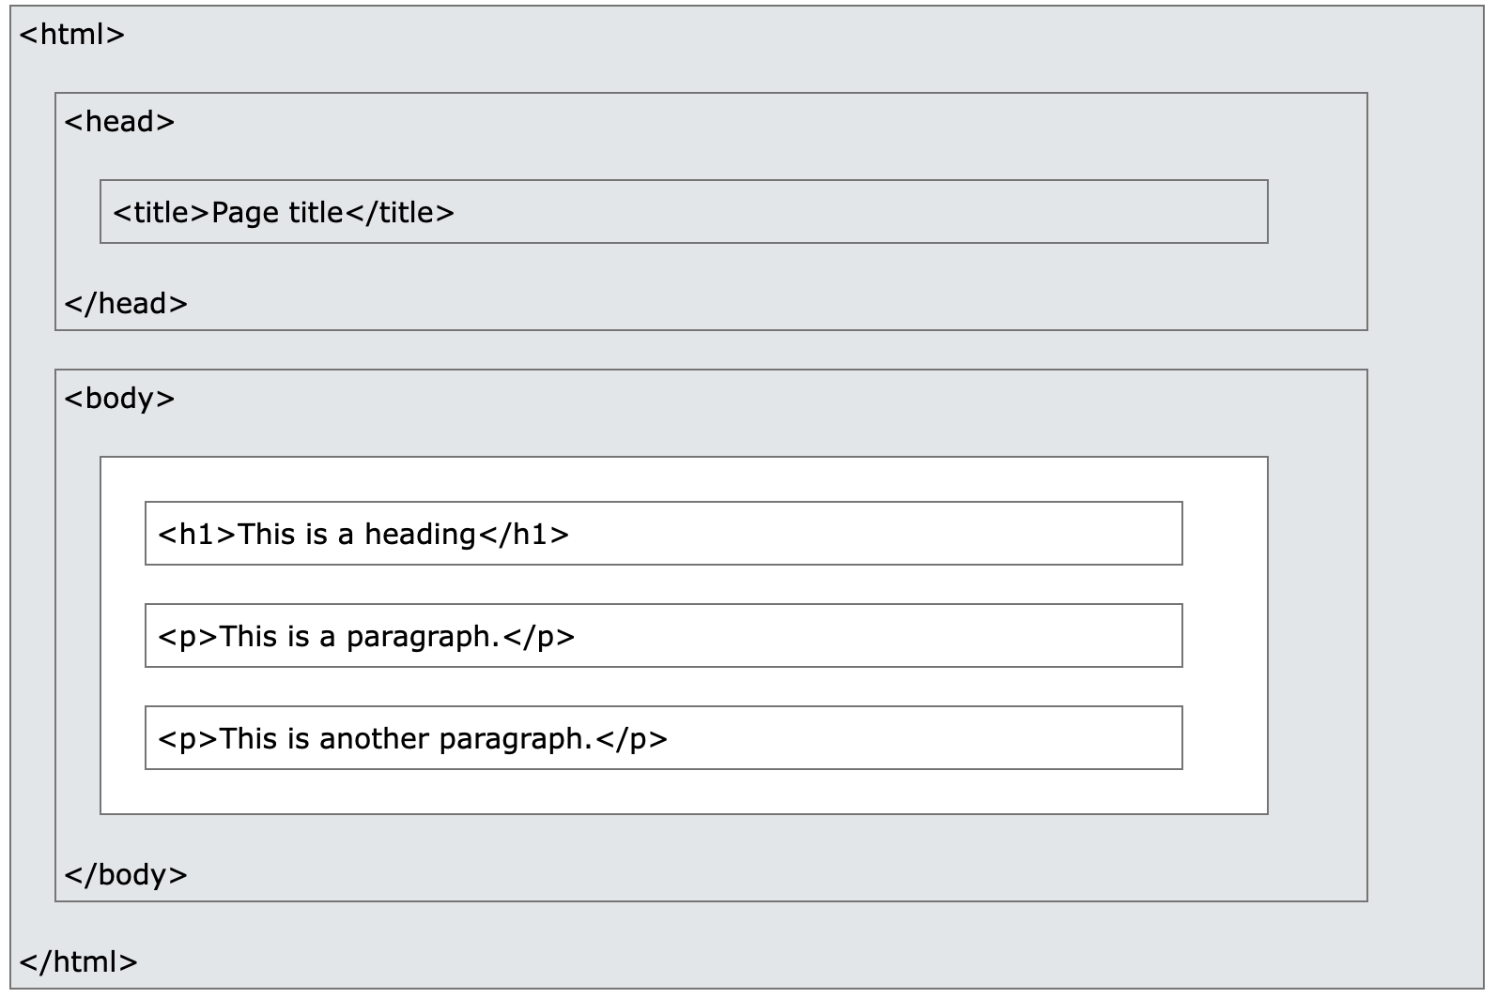
Visualization of HTML page structure

Slide 10
Let’s learn some basic tags!
Please log in to Replit.

Slide 11
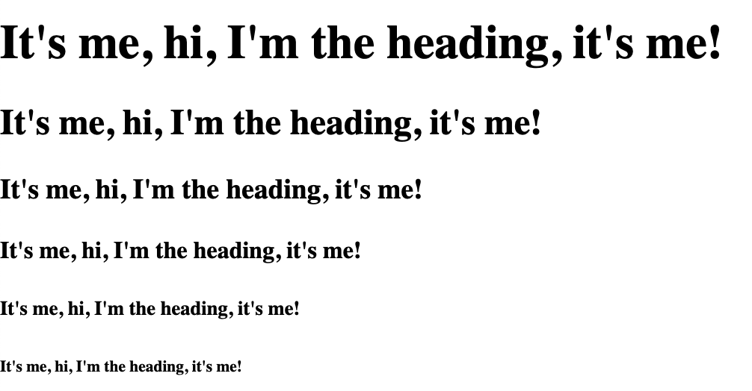
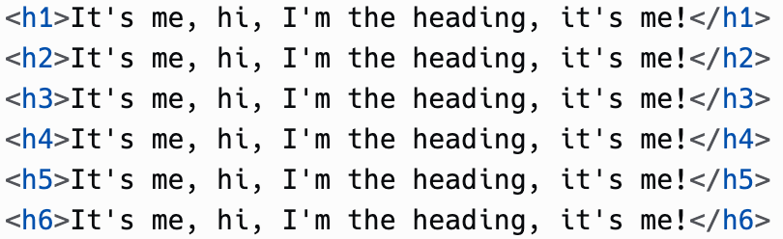
Some headings

Slide 12

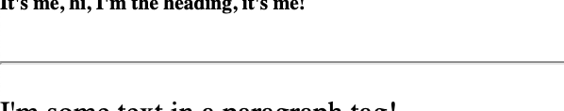
Divider (oh look it’s an empty element!)
Stretches across the webpage horizontally

Slide 13

Paragraph text (i.e. regular text)

Slide 14
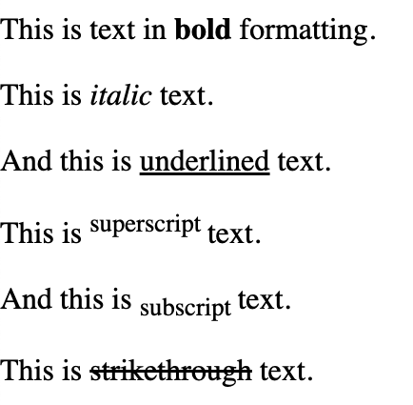
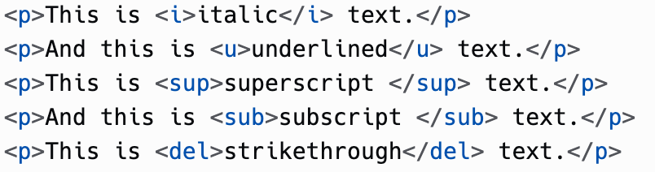
Text formatting!
See how I coded the first sentence.
If I told you I used <i>, <u>, <sup>, <sub>, and <del> for each subsequent line, how would you code it?

Slide 15
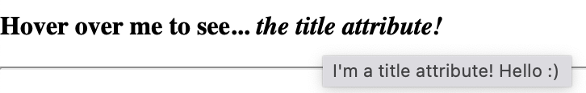
Let’s try something cool… the title attribute!
Kind of like a hidden message… hover over it to see more text!

Slide 16
Lists, table, and input!

Slide 17
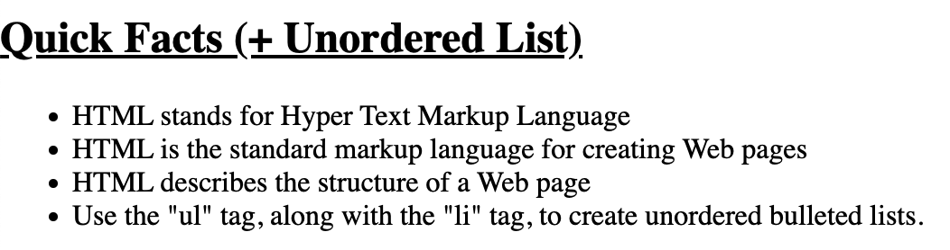
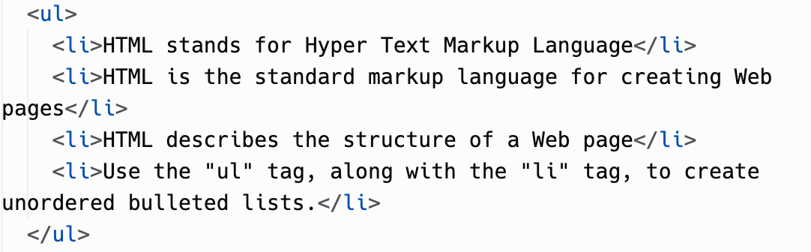
Unordered List

Slide 18
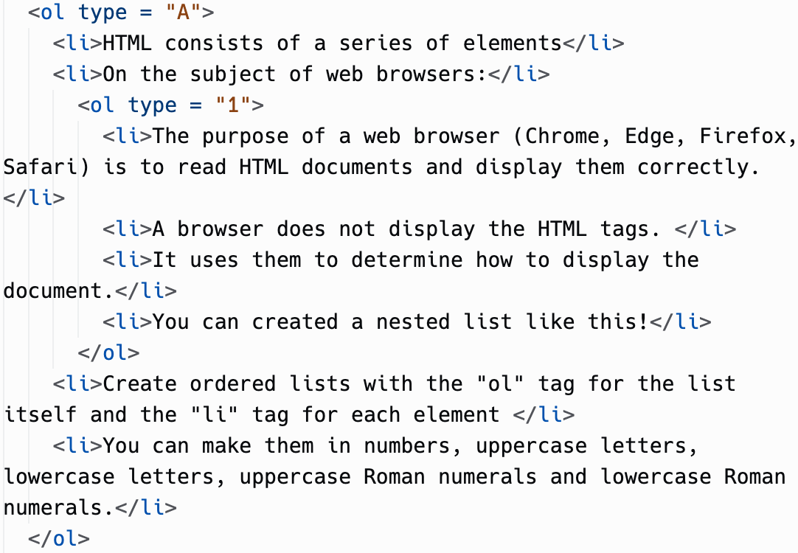
Ordered List

Slide 19
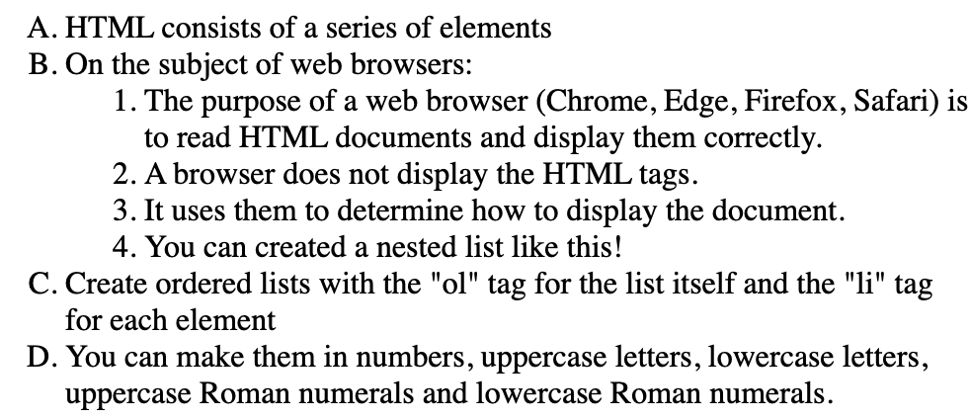
Ordered List (cont)

Slide 20
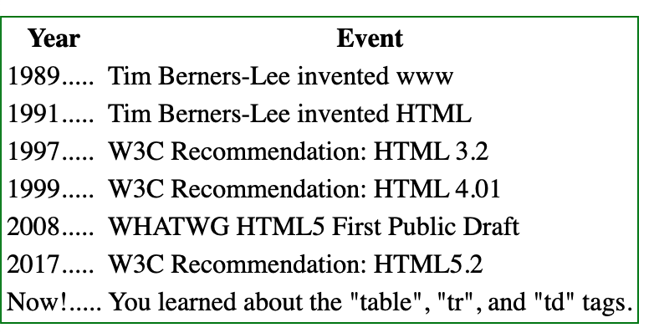
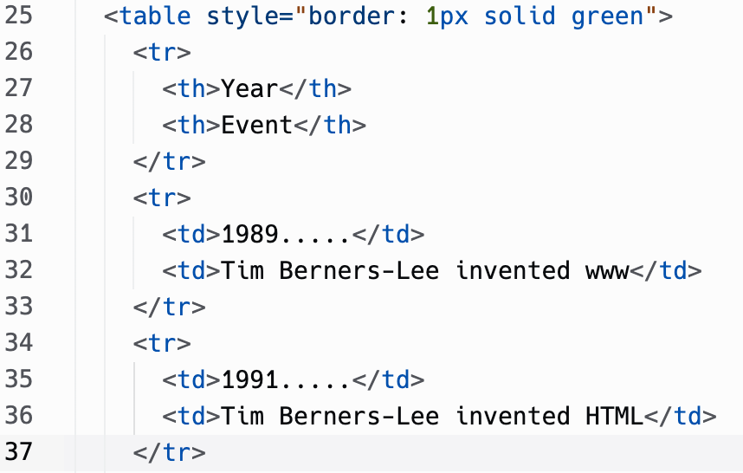

Table
…

Slide 21
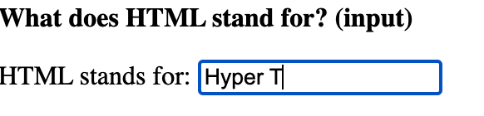

Text Input

Slide 22
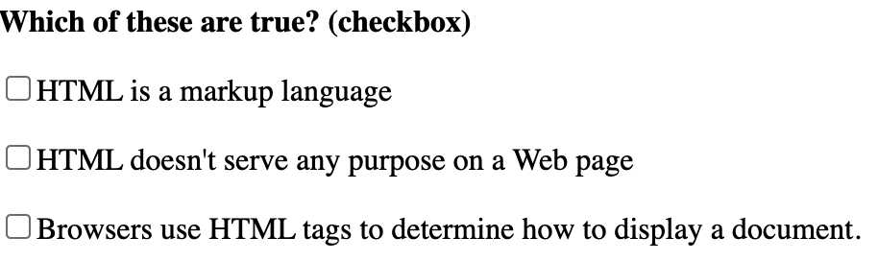
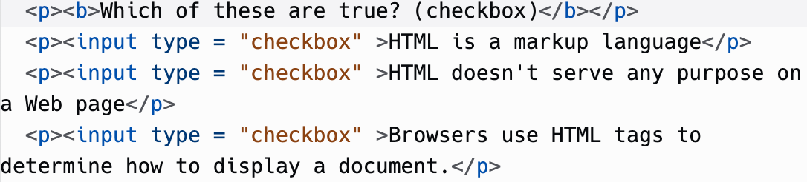
Checkbox Input

Slide 23
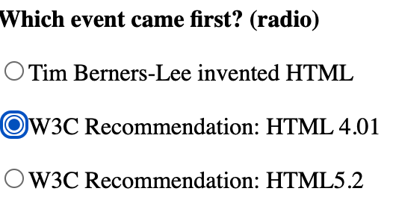
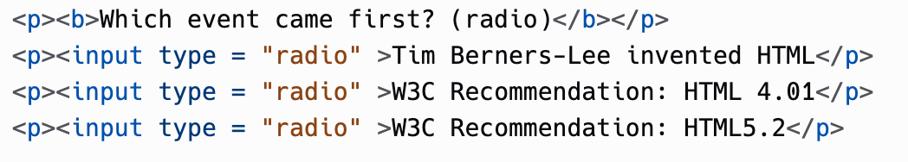
Radio Input

Slide 24
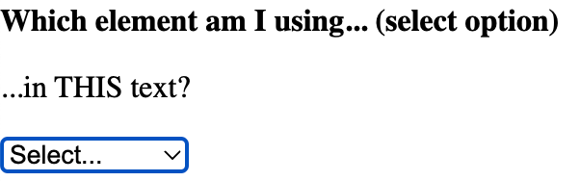
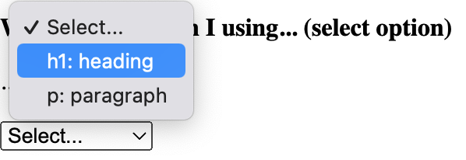
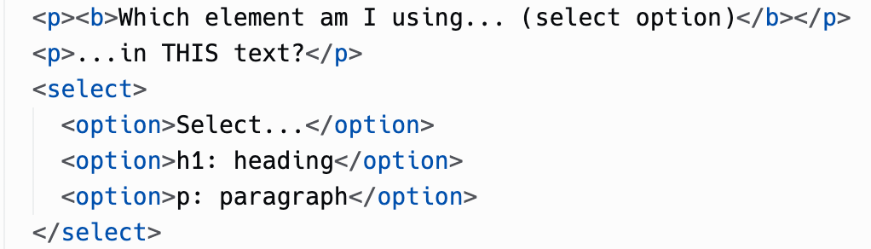
Select Input

Slide 25
Activity!

Slide 26
Create a short All-About-Me page!
Different sections, separated by dividers <hr>
At least 3 sections
Bio: full name, grade, school, fun fact about you.
Favorite things: e.g. books, places, activities, people, colors, etc. (at least 2 of the above)
Quiz: At least 4 questions
For each section, use a heading, e.g. <h2> with either bold, italic, or underline

Slide 27
Requirements
Bio section:
Use a paragraph element for regular text.
Favorite things:
Use an unordered list somewhere in the section and an ordered list somewhere else.
Quiz:
Create at least one question of each input type we learned (checkbox, text, radio, select). (Total of at least 4 questions)

Slide 28
Bonus Points
+1 → use a nested ordered list
+1 → use a table
+1 → use a title attribute

Slide 29
Thanks & Happy Hacking!

